Slide 1

Krazy Kode
It works, but why?!
Eli Kaski
March 2021

Slide 2

$ whoami
Eli Kaski
Worked at Check Point as a Malware Researcher
Like reverse engineering, looking at assembly, and trying to understand how things work behind the scenes
I also like solving CTF challenges (and writing CTF challenges ☺)
Notes:
It was my job to receive an executable and figure out what it’s doing

Slide 3
Agenda
What
Why
Examples
Conclusion
References

Slide 4

What
This presentation is about funny and esoteric cases of obfuscation
“Obfuscation is the deliberate act of creating source or
machine code that is difficult for humans to understand”
-Wikipedia
Notes:
This presentation is about some examples for code manipulations that I liked
The examples show concepts that would make the job for someone who tried to reverse engineer a program – much, much harder

Slide 5
Why
Basically, people want to hide their code. Some of the use cases I can think of:
Companies want to hide their proprietary stuff from competitors
Protect your code from hackers – if they can’t see it, it will be harder for them to attack it
Hackers don’t want to reveal their techniques to security researchers
“Job Security” – if I’m the only one who understands the code, they can’t fire me (yes, this is real)
IOCCC, The International Obfuscated C Code Contest - contest for the most creatively obfuscated C code
For fun, messing around with your friends
Notes:
I’m going to focus on the last reason :)

Slide 6
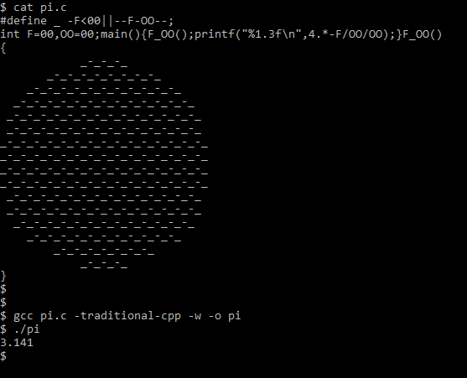
IOCCC – Pi (π)
One of my favorite examples is the following entry from 1988 IOCCC that calculates an approximation of Pi (π):
(Taken from https://en.wikipedia.org/wiki/International_Obfuscated_C_Code_Contest#Pi)
The program has: An underscore ( _ ) macro 2 global variables: F and OO 2 functions: main and F_OO
The main function calls F_OO function
Then main prints some calculation on F and OO, which is a nice approximation of Pi
F_OO function looks weird – it contains a circle, and it’s probably changing F and OO
F_OO uses the underscore macro
Each line is made of underscores and minus signs
Let’s see how it works
Notes:
Just to see what we’re talking about, I’ll start with one of my favorite examples from IOCCC

Slide 7
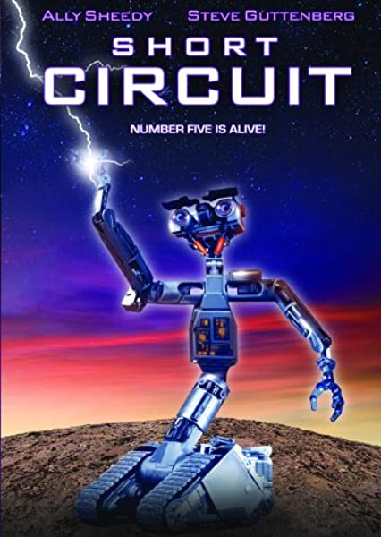
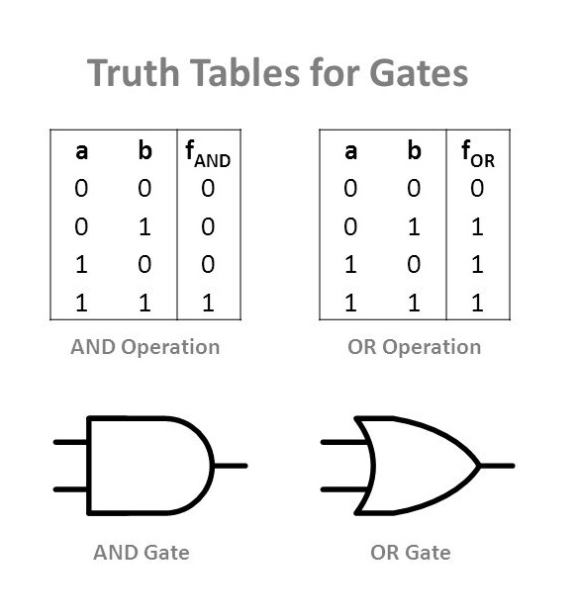
IOCCC – Pi (π)
First, a little bit about short-circuit evaluation in C
By the definition of “and” operation, if the first argument is false, then the entire expression is false - so there is no need to evaluate the second argument.
Similarly, in “or” operation, if the first argument is true, there is no need to evaluate the second argument.
This method of evaluating only the necessary arguments is called “short-circuit”, and it is used in C.
Notes:
Movie from 1986

Slide 8
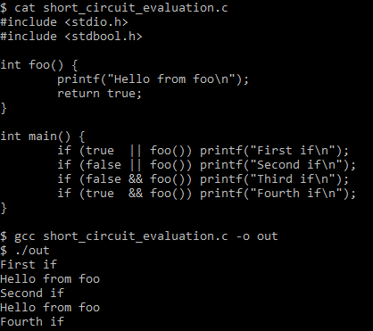
IOCCC – Pi (π)
A simple short-circuit example in C
Take a look at the following program:
Function foo always returns true. What do we expect to be printed?
OR - First argument is true, no need to call foo, printf is called
OR - First argument is false, need to call foo, printf is called
AND - First argument false, no need to call foo, printf is not called
AND – First argument is true, need to call foo, printf is called
Now that we understand short-circuit evaluation, lets go back to our code

Slide 9
IOCCC – Pi (π)
The underscore macro is defined as: “-F<00||--F-OO--;”
So “_-_-_” (beginning of each line) will be expanded to:
-F<00||--F-OO--; --F<00||--F-OO--; --F<00||--F-OO--;
(I have added newlines for clarity)
Notice that the minus sign in between underscores is prepended to the “-F” of the underscore macro to the right, changing the macro from negation to pre-decrementation.
The first underscore macro (the first line in the example) checks if -F is negative. Since F is initialized to zero this evaluation is false, so the right-hand side of the macro is evaluated – which decreases both F and OO, so they are both -1.
The next underscore macro first decreases F, which becomes -2, and then checks if this new value of F is negative, which is true – so the expression on the right-hand side of the macro is not evaluated.

Slide 10
IOCCC – Pi (π)
If we continue with this logic, it is easy to see that every underscore macro at the beginning of a line decreases both F and OO, and every other underscore macro only decreases F.
This means that F counts the underscore signs “_”, and OO counts the amount of lines.
In other words, F holds the (negative) area of the circle, and OO holds the (negative) diameter of the circle.

Slide 11


IOCCC – Pi (π)
F holds the (negative) area of the circle OO holds the (negative) diameter of the circle.
Now, using the formula for calculating the area of a circle: $A=πr^{2}=π{\left(\frac{d}{2}\right)}^{2}=\frac{π}{4}d^{2}$ we get $π= \frac{4A}{d^{2}}$
So we can calculate Pi using the area and the diameter.
In our case, A=-F and d=-OO
That is exactly what happens in the printf call inside main function:

Slide 12

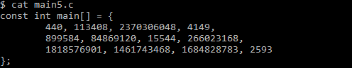
Main is usually a function
Look at the following program
Something seems strange – instead of as a function,
“main” is defined as a const int array

Slide 13
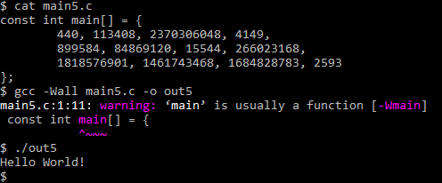
Main is usually a function
However, it somehow compiles
With the strange warning: “main” is usually a function
And it magically prints “Hello World!”

Slide 14
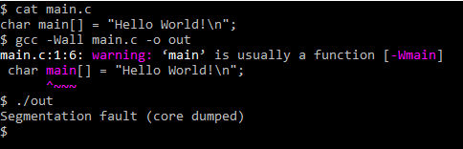
Main is usually a function
How does it work?
First of all, it is possible to create a non-function main:
But how do we create meaningful functionality?

Slide 15
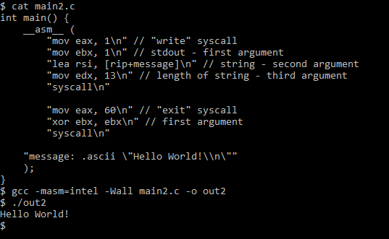
Main is usually a function
Creating meaningul code -
A simple “Hello World!” program

Slide 16
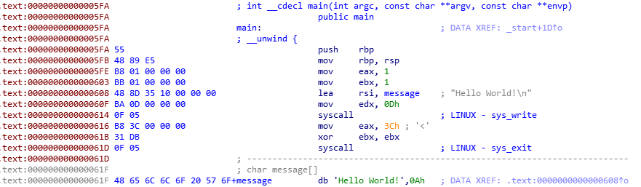
Main is usually a function
Opening our program in a disassembler, it looks like this:
Notes:
A disassembler is a tool that takes a compiled executable, and displays the machine code (hex values to the left) alongside their corresponding assembly instructions (to the right)

Slide 17
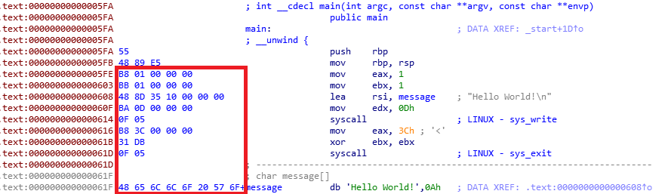
Main is usually a function
Opening our program in a disassembler, it looks like this:
We can take just the bytes corresponding to our code, and define main as an array of those bytes

Slide 18
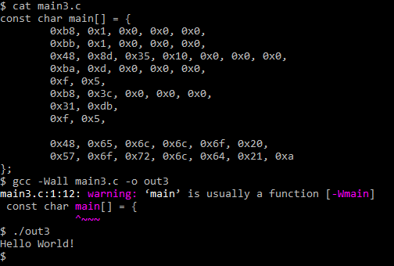
Main is usually a function
H e l l o space
W o r l d ! newline

Slide 19
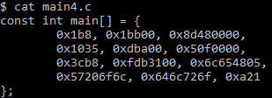
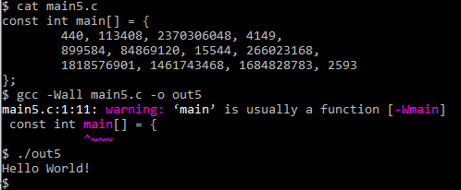
Main is usually a function
Then, reorganizing it:
bytes to ints
hex to dec

Slide 20
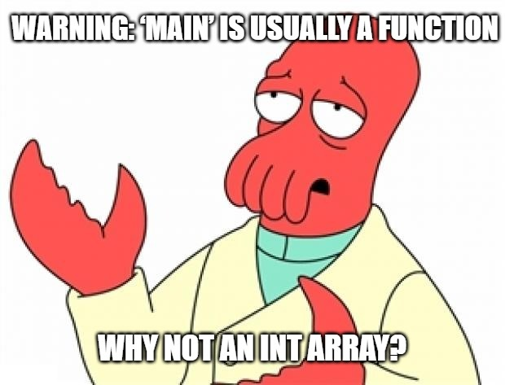
Main is usually a function
And finally,

Slide 21

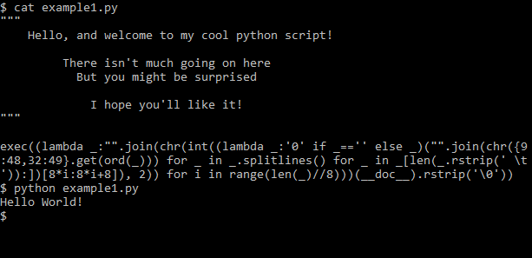
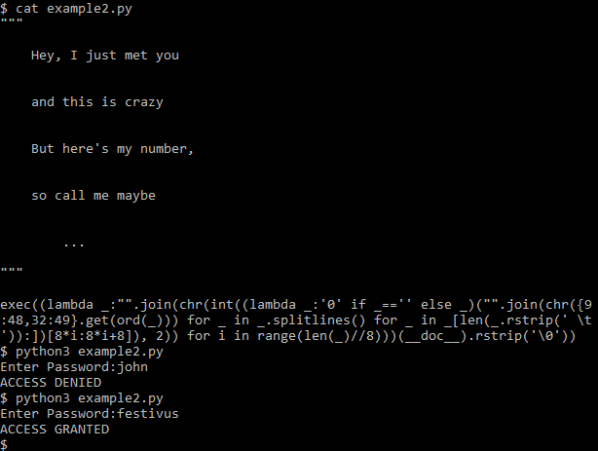
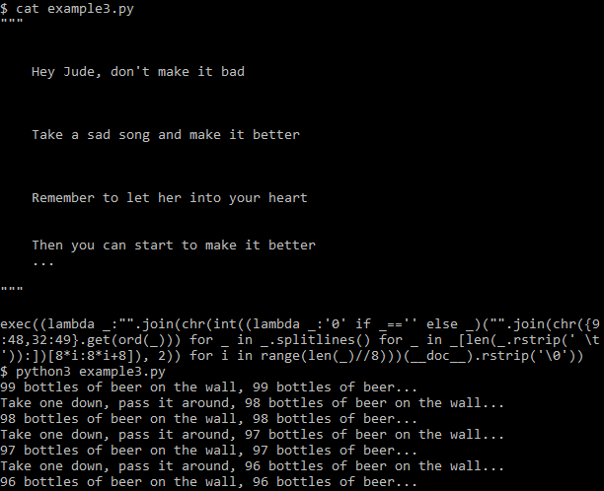
Read the docs
Take a look at these 3 python scripts
They all contain one identical line of code, but perform different functions...
Notes:
Focus on the script to the left, we will open it in a hex editor

Slide 22
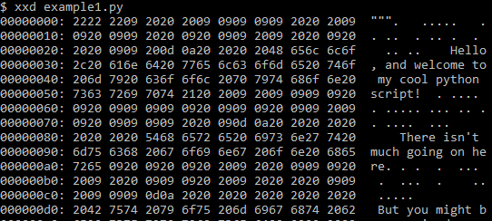
Read the docs
spaces
Opening a script in a hex editor,
We see that the documentation contains hidden whitespaces: tabs and spaces
tabs

Slide 23
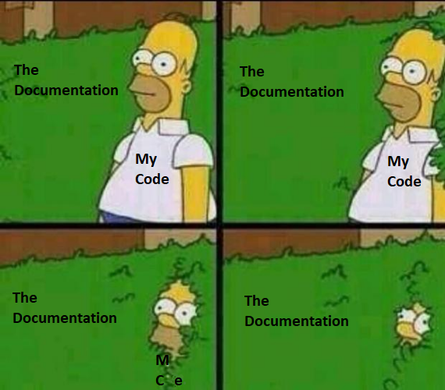
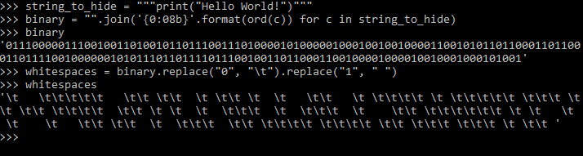
Read the docs
The idea – hiding code in the documentation
Encode the “hidden” code using whitespaces - spaces and tabs
Add these whitespaces to the documentation
Decode them in runtime and execute the code

Slide 24
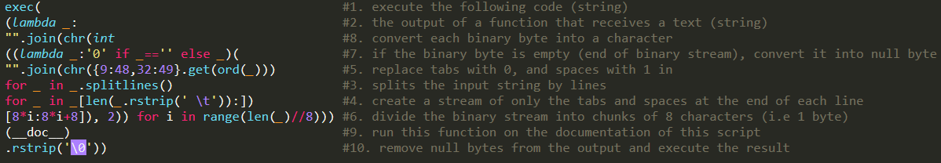
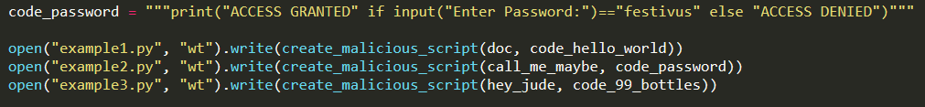
Read the docs
The one-liner of each script decodes the python code from the documentation and runs it
So we can create scripts with arbitrary code and documentation that will have the same visible code.
This is how I generated the 3 examples:

Slide 25
Movfuscator
As you may know, C code is compiled into various assembly instructions
For example, in Intel’s x86 architecture: add, xor, cmp, push, jmp, mov, and more
These instructions are called an instruction set
This instruction set is powerful enough to implement our C code
And is said to be “Turing-complete”

Slide 26
Movfuscator
Turing-Completeness
“A system of data-manipulation rules (such as a computer's instruction set) is said to be Turing-complete if it can be used to simulate any Turing machine. Turing completeness is used as a way to express the power of such a data-manipulation rule set. Virtually all programming languages today are Turing-complete.”
- Wikipedia
(Basically means “can compute things like a computer”)

Slide 27
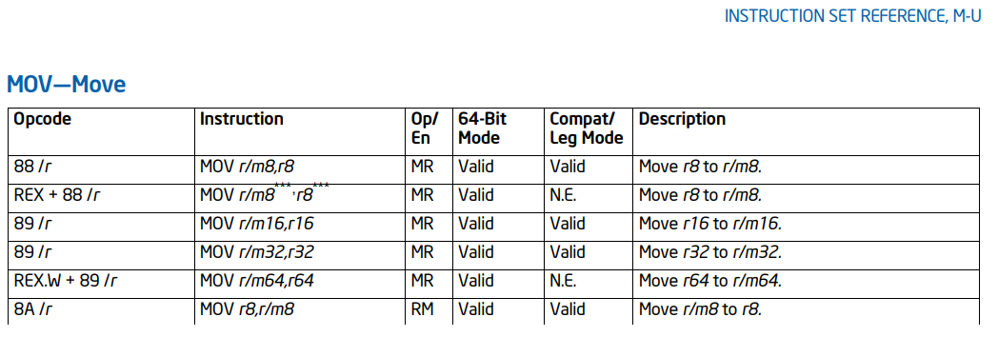
Movfuscator
As it turns out, the entire x86 instruction set can be reduced to a single instruction and remain Turing-complete (!!!)
This magical instruction is MOV
Taken from Intel® 64 and IA-32 Architectures Software Developer’s Manual

Slide 28

Movfuscator
Introducing:
Movfuscator - “The single instruction C compiler”
Created by Chris Domas, @xoreaxeaxeax Available on GitHub: https://github.com/xoreaxeaxeax/movfuscator Inspired by the paper mov is Turing-complete
Basically, compiles C programs into only MOV instructions

Slide 29
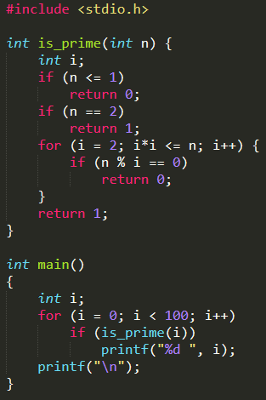
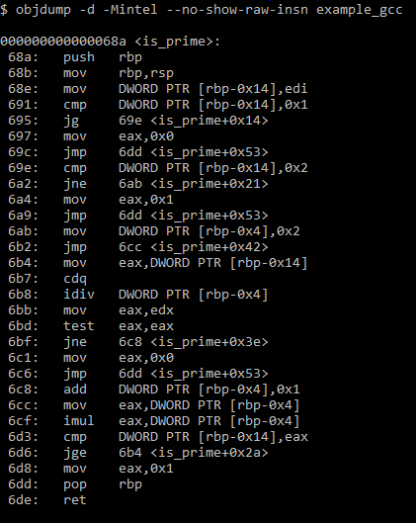
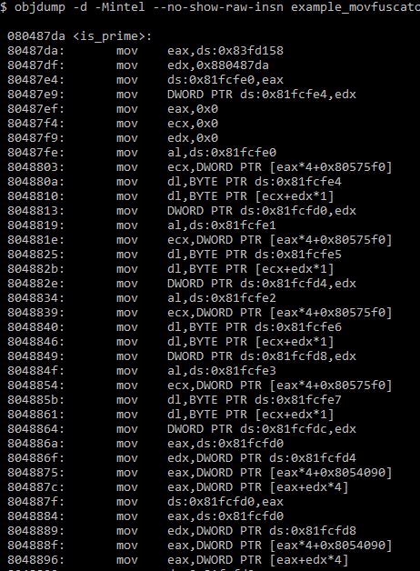
Movfuscator - Example
C Source Code GCC Compilation Movfuscator Compilation
Imagine trying to figure out what this code does by reading the assembly... A nightmare

Slide 30

Movfuscator
But how does it work?
How can we implement the entire complex x86 instruction set
using just the MOV instruction?
In the following slides I will introduce some of the concepts for
how to implement basic “primitives” using only MOV instructions
Notes:
Explain that I’m using the convention where
mov a, b means moving from b to a (from right to left)

Slide 31

Movfuscator
Basic primitives using only MOV instructions
Checking equality: x == y?
The idea - use x and y as indexes in an array:
mov arr[x], 0 ; write 0 at address x
mov arr[y], 1 ; write 1 at address y
mov result, arr[x] ; read address x into register result
If x == y then we will read 1 from arr[x] If x != y then we will read 0 from arr[x]
In both cases, the “result” register will hold the answer
Notes:
Explain that I’m using the convention where
mov destination, source
mov a, b means moving from b to a (from right to left)

Slide 32
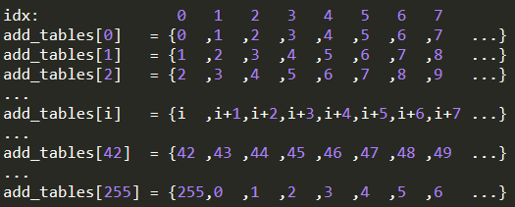
Movfuscator
Basic primitives using only MOV instructions
Addition: x + y = ?
Lets limit ourselves to 8-bit calculations The compiler creates an array of 256 (2⁸) precomputed lookup tables Each entry is of size 256, we’ll call this array add_tables It is defined such that add_tables[x][y] = x + y
So our instructions would be:
mov ptr, add_tables[x] ; register ptr holds a pointer to a table
mov result, ptr[y] ; register result holds x + y
We do the same for calculating the carry Substraction, multiplication and division are done similarily, with lookup tables Bitwise operations - and, or, xor, not, shifts – are also done similarily
Using carry and bitwise operations primitives, we can simulate 32-bit calculations
Notes:
We limit ourselves to 8-bit because if we create lookup tables of 2^32, the result file with be hundreds of gigabytes

Slide 33

Movfuscator
But what about if & else branches?
MOV is an uncoditional instruction!
This means that all paths execute, no matter what.
How can you simulate a conditional branch?
Well, you can’t. But...

Slide 34
Movfuscator
We can force a path that shouldn’t be taken, to work on “dummy” data
We will have a selector, which will hold either “real” or “dummy” pointer
Lets say our code is:
If (x == y) x = 100;
Then our selector will be the following 2-elements array:
selector = {&dummy, &x}
And the code will compile to something like:
mov arr[x], 0 ; write 0 at address x mov arr[y], 1 ; write 1 at address y mov result, arr[x] ; if x==y then result=1. otherwise result=0
mov eax [selector+result] ; eax holds a pointer to either “dummy” or x mov [eax], 100 ; write 100 to either “dummy” or x
When the branch should not be taken, it technically runs,
but does not affect anything. Thus simulating a conditional branch

Slide 35
Movfuscator
Well, what about loops?
Mov instructions go only in forward direction
How would you jump back to the beginning of the loop?

Slide 36
Movfuscator
We will insert a jmp from the end of our code – back to the beginning (we will fix that later) So our program will look something like this:
start: 0x1000: mov ... 0x1004: mov ... 0x1008: mov ... 0x100c: mov ... 0x1010: mov ... 0x1014: mov ... 0x1018: mov ... 0x101c: mov ... 0x1020: mov ... jmp start
Now, let’s say we want to jump from 0x1018 to 0x1004
At 0x1018, we will store the destination address, 0x1004, in a “target” variable
Next, we switch all the selector pointers into a “dummy” pointer, practically meaning the execution is “off”
Now, in every block of movs, the first thing we do is to check if our current address matches the “target” variable
If not, then all the movs continue to work on the dummy pointer
Once we reach the address that matches the target address, we switch back all the pointers to normal, and continue execution
Target: 0x1004
Execution:
We are here
ON
Continue normally
OFF
We are here
We are here
We are here
We are here
Thus simulating loops and branches

Slide 37
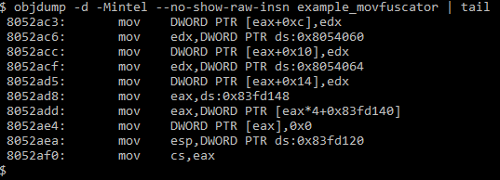
Movfuscator
What about that jmp instruction at the end?
We can use x86’s exception handling mechanism to get around that
We will insert an illegal mov instruction at the end of our code
And let our function be its own illegal signal exception handler
Which will cause an illegal signal exception Thus running our function again
An illegal mov can be “mov cs, eax” – can be encoded but not executed
Because the program will throw exceptions recursively, in order to prevent a stack overflow, we will reload the stack pointer after every iteration
This causes our program to practically run in a loop
In order to halt the program, we cause a segfault For example, reading from address 0
Notes:
You might think that a mov to an illegal memory location, such as null, could be an illegal move
A mov to a null pointer would actually be a memory access exception, and a legal mov instruction
In short, CS register holds “code segment” pointer. It is used only in real mode, and illegal for protected mode
To halt the program, we cause segfault (reading from 0), and set the segfault handler to be “after our main function”. i.e. Back to the OS’s library that handles the process

Slide 38
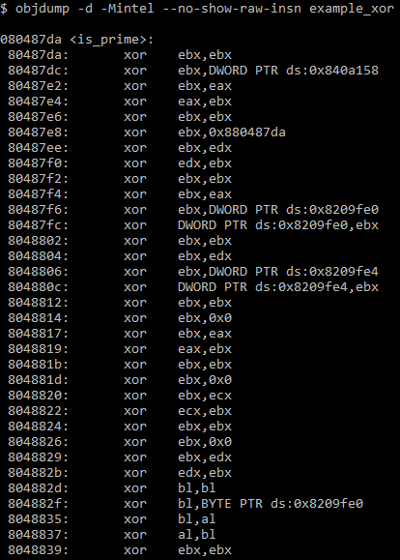
Movfuscator
The result – a program that is compiled to only mov instructions
Looking for other Turing-complete instructions... xor is a good candidate, because a mov can be implement using 2 xors
For example:
mov eax, 1234
Can be implemented as:
xor eax, eax ; eax = 0
xor eax, 1234 ; eax = 1234
This only means one thing...
Xorfuscator!
In fact, there are more x86 instructions that are Turing-complete by themselves:
add, adc, sub, sbb, xadd, rcr (1-bit shift)
Notes:
Addc – add with carry
Sbb – subtract with borrow
Xadd – exchange and add
Rcr – rotate with carry right

Slide 39
Movfuscator
And as it turns out, there is a whole family of single-instruction Turing-complete machines
Some of them are based on different arithmetic operations:
Incrementation – P1eq – plus 1 and branch if equal to another value
Decrementation – DJN – decrement and branch (jump) if nonzero
Addition: addleq – add and branch if less than or equal to zero
Subtraction: subleq – subtract and branch if less than or equal to zero

Slide 40

Movfuscator
So how do we reverse engineer a movfuscated program?
Demovfuscator is a GitHub project dedicated to this:
https://github.com/kirschju/demovfuscator
“This tool constitutes a generic way of recovering the control flow of the original program from movfuscated binaries”

Slide 41
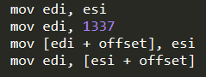
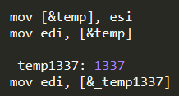
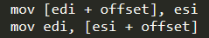
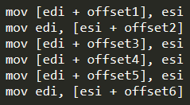
Reductio
Now, going back to our mov-compiled program
Is there a way to reduce it even further?
First, notice that not all of our movs are identical. There are 4 types of movs:
Lets reduce the register-to-register, and constant-to-register, into memory-to-register
Now we can reduce our program to only movs in the form:
So our program will look something like:
Notes:
4 types of movs are register to register, constant to register, register to memory, memory to register
In practice there is also the problem with addressing just 8/16 bits, so need multiple writes and reads in order to only load or store 8 bits

Slide 42
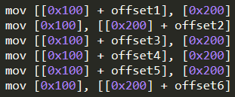
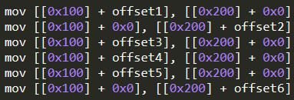
Reductio
Next, let’s get rid of edi and esi and use constant addresses in memory instead These constant addresses will be used as “pseudo registers” For this example, we’ll store edi in 0x100, and esi in 0x200
To make the “read” and “write” instructions symetrical, we’ll add a 0 where there is no offset:
Notes:
This is technically not a valid x86 instruction, but we use this syntax for simplicity, and later we will implement it using only x86 instructions
(if asked by audience) explain that in the second transition we have added a layer of dereference ([0x200] turned into [[0x200] + 0x0])
This is to make read/write instructions identical, and in reality we do [[0x210] + 0x0] where 0x210 holds a pointer to 0x200

Slide 43
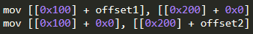
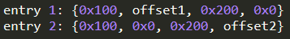
Reductio
Now for the magic
All of our mov instructions (read/write) look the same now The only difference between them is those 4 constants
We can extract those constants into a table Each entry in the table will contain 4 constants and will represent one mov instruction
This means we have reduced the logic of the entire program into one big table of constants
All that’s left to do is write a code that executes those movs based on the constants in the table

Slide 44
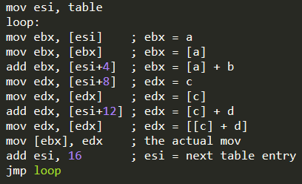
Reductio
Simulating a mov with our table
Each entry in the table looks like And represents a mov like
The following code goes through the table and performs all the movs

Slide 45
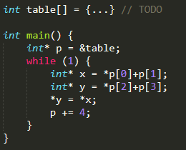
Reductio
Introducing:
Reductio reductio ad absurdum - Latin for “reduction to absurdity”
https://github.com/xoreaxeaxeax/reductio
Any C program can be reduced to exactly this set of instructions
So the next time your manager asks you if you’ve finished the feature you’re working on,
tell them the code is all done, and you just gotta figure out this data table ☺
Notes:
This instruction stream implements every program that ever has been or ever will be written
The difference between this and an emulator is that an emulator reads an instruction from the program, and then decide what to do based on that instruction
This instruction set is executed always, regardless of what program its actually running

Slide 46
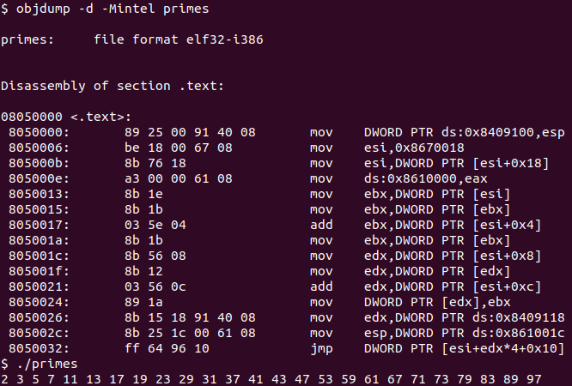
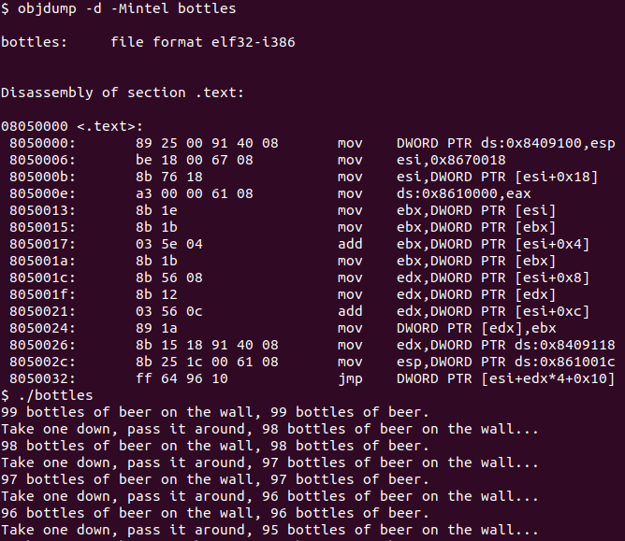
Reductio
The result:
Programs with identical code, that perform different things
Notes:
Explain that in the previous slides I had simplified things like:
Make the jump a bit more complicated – it is used to jump to external non-reduced libraries, for calls like malloc
And needing to get the return value and reset the stack pointer in those cases
In practice, if we compile the library ourselves, then we could remove the jmp into simply jmp to 0x805000b
The program uses MMIO (memory mapped IO) to print. If the OS does not support sufficient MMIO, then syscalls paths will be needed

Slide 47
Brainfuck
Another example of a turing complete machine, notable for its extreme minimalism.
Brainfuck is an esoteric programming language consisted of only 8 instructions. It uses an instruction pointer, a one-dimensional data array, and a movable data pointer that points to cells the array.
Resulting in code that is extremly difficult to understand, hence it’s name.
For example, the following is a program that inputs 2 numbers, adds them, and outputs the result
,>,[<+>-]<.
input to arr[0], move to arr[1], input to arr[1], while (arr[1] != 0) {move to arr[0], increase, move to arr[1], decrease} move to arr[0], output
Inst | Meaning
> | data_pointer++
< | data_pointer--
+ | (*data_pointer)++
- | (*data_pointer)--
[ | if (*data_pointer == 0) goto ]
] | If (*data_pointer != 0) goto [
. | output *data_pointer
, | Input into *data_pointer

Slide 48
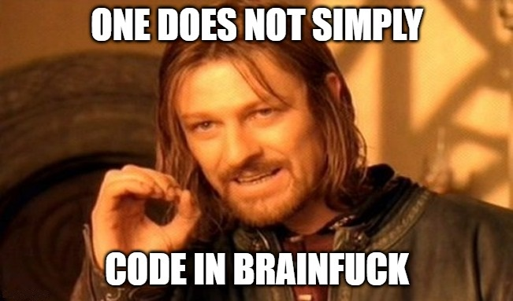
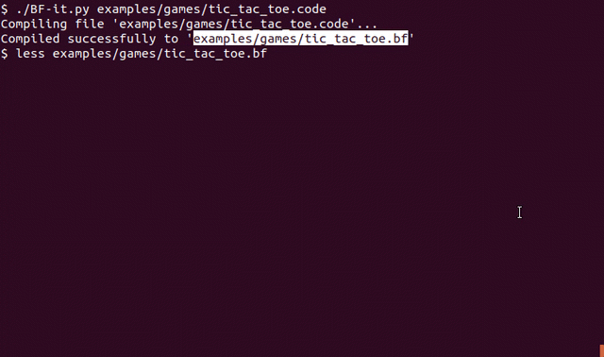
Brainfuck
A simple “Hello World” program: ++++++++++[>+++++++>++++++++++>+++>+<<<<-]>++.>+.+++++++..+++.>++.<<+++++++++++++++.>.+++.------.--------.>+.>.
And more “interesting” simple programs might result in thousands of lines!
There are “compilers” from C to Brainfuck code: https://github.com/elikaski/BF-it
With such compilers it is easy to create more interesting programs in Brainfuck
For example, games such as Tic-Tac-Toe, Tetris, Snake...
This is a 17.8KB Brainfuck code for Tic-Tac-Toe:

Slide 49
JSFuck
JSFuck is an esoteric subset of JavaScript, where code is written using only six characters: [, ], (, ), !, and +. JSFuck is valid JavaScript code, meaning that JSFuck programs can be run in any JavaScript interpreter.
For example, the number 0 is created by +[], where [] is the empty array and + is the unary plus, used to convert the right side to a numeric value (zero here). The number 1 can be created by +!+[], that is the same as +!0, which is +true, which evaluates to 1.
The letter “a” can be taken from the string “false” like: “false”[1] 1 can be created like we just saw: +!+[]. And “false” can be created with (false+[]) which can be formatted like (![]+[]) – negation of an empty array. The result is (![]+[])[+!+[]] which is evaluated to “a”.
With these format tricks, one can create an entire JavaScript program using just these six characters.
There are even websites that do it for you: https://jscrew.it/, http://www.jsfuck.com/
Notes:
This is possible because JavaScript is weakly typed – meaning there are “loose” type rules allowing implicit type conversions

Slide 50
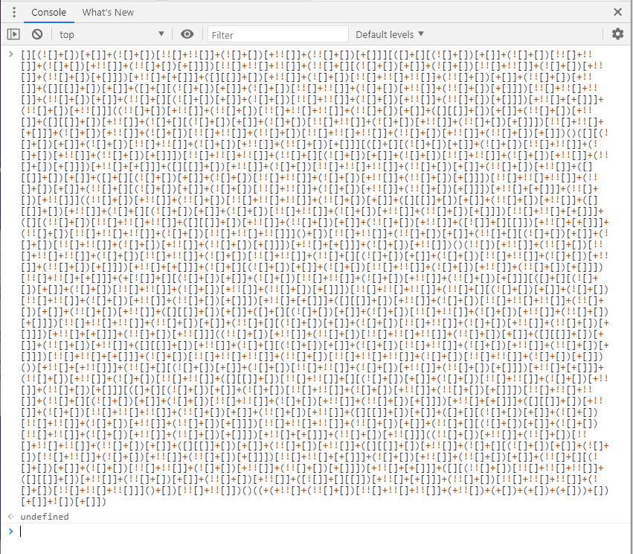


JSFuck
For example, a simple
alert("Hello World!")
Is converted to 4325 characters:
And the result:

Slide 51
Irregular Expression
In this example, we will talk about Regular Expressions
“A regular expression is a sequence of characters that define a search pattern. Usually such patterns are used by string-searching algorithms for ‘find’ operation.”
- Wikipedia
Basically we define a search pattern, and find a substring that matches this pattern in our text string.
For example, the pattern “only digits” will find a match in the string “hello world 123” That’s because it contains the substrings “123” which is only digits. However, the pattern “start of line, only digits, end of line” does not match this string.

Slide 52
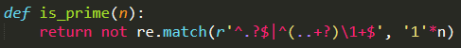
Irregular Expression
Take a look at the following Python function
It receives an integer, and using this strange regular expression, somehow determines if that integer is a prime
So how does it work?
First, lets explain what each sign means:
Before we try to understand the pattern, let’s understand which string we are trying to match
Given a number n, we construct a string that is ‘1’*n E.g. if n=3, then the string is “111” and if n=10, then the string is “1111111111” and so on...
Sign | Meaning
. | Any character
? | Zero or one occurence
+ | One or more occurences
^ | The beginning of the line
$ | The end of the line
| | Or. Match whatever’s on The left side or the right side
() | capture a group
\num | reference to a captured group

Slide 53
Irregular Expression
We’ll start with the right side of the expression
The (..+?) means that we try to match 2 or more characters, and we refer to them as a group
Then, the \1+ means that we try to match this group at least one more time
The ^ at the beginning, and $ at the end make sure that we will try to match the whole string, and not just a substring of it
Sign | Meaning
. | Any character
? | Zero or one occurence
+ | One or more occurences
^ | The beginning of the line
$ | The end of the line
| | Or. Match whatever’s on The left side or the right side
() | capture a group
\num | reference to a captured group
Notes:
In practice the + sign causes the regex engine to first try the longest possible match, i.e (n-1), then (n-2), up to 1
The ? sign makes + operation non-greedy, which is there for performance reasons – it makes the regex engine iterate from 2 to n instead of from n to 2
In simple words, it means we start at i=2, and check if the length of the rest of our string divides by i We continue doing so until i=n and then we stop
If there exists an i that matches this pattern, then we return False
If no such i exists then we return True

Slide 54
Irregular Expression
Let’s simulate a run on n=9
Our string will become “111111111”
First iteration: The (..+?) will try to match “11” and then the \1+ will try to match “11” repeatedly until the end of our string: 111111111
Second iteration: The (..+?) will then try to match “111” and then the \1+ will try to match “111” repeatedly until the end of our string: 111111111
The string does match our pattern So the function will return False Indicating n is not prime
Sign | Meaning
. | Any character
? | Zero or one occurence
+ | One or more occurences
^ | The beginning of the line
$ | The end of the line
| | Or. Match whatever’s on The left side or the right side
() | capture a group
\num | reference to a captured group
– no match
– match

Slide 55
Irregular Expression
Now let’s simulate a run on n=7
Our string will become “1111111”
First iteration: The (..+?) will try to match “11” and then the \1+ will try to match “11” repeatedly until the end of our string: 1111111
Second iteration: The (..+?) will then try to match “111” and then the \1+ will try to match “111” repeatedly until the end of our string: 1111111
This will continue for 1111111 , 1111111 1111111 , 1111111 at which the regex engine will stop trying to match, because the group to match is longer than our entire string.
The function will return True, indicating n is prime
Sign | Meaning
. | Any character
? | Zero or one occurence
+ | One or more occurences
^ | The beginning of the line
$ | The end of the line
| | Or. Match whatever’s on The left side or the right side
() | capture a group
\num | reference to a captured group
– no match
– no match

Slide 56
Irregular Expression
Now what’s with the left side of the pattern?
.? means match 0 or 1 characters
And the ^ and $ make sure this match will cover the entire string
It’s basically there to deal with the cases of n=0 and n=1
Sign | Meaning
. | Any character
? | Zero or one occurence
+ | One or more occurences
^ | The beginning of the line
$ | The end of the line
| | Or. Match whatever’s on The left side or the right side
() | capture a group
\num | reference to a captured group

Slide 57
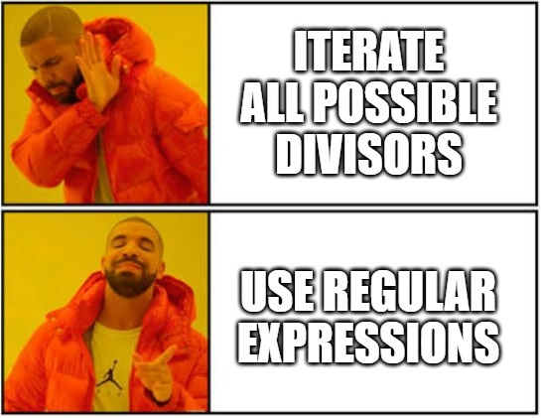
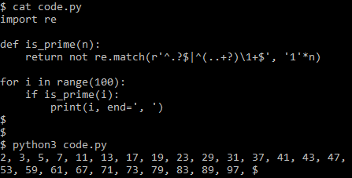
Irregular Expression
The result – use of regular expressions to determine if a number is prime
Determine if a number is prime

Slide 58
printf-tac-toe
Sign | Meaning
%d | Print integer
%s | Print string
%n | Write # of bytes written so far
%hhn | Like %n, only mod 256
%08d | Print integer padded with 8 zeros
%8s | Print string padded with 8 spaces
%x$y | Print argument #x in format y
%1$.*2$d | Print argument 1, padded with as many zeros as in argument 2
As you may know, printf is a very versatile function. Some of its known format strings are summarized in this table:
We can combine them and craft clever format strings that will perform some kind of desired functionality
For example, the following expression: printf("%1$.*2$d%3$hhn", 5, 10, &x) will have the same effect as if we had written x = 10; Because it will print out 0000000005 (5 padded to size 10) And then write the number of bytes (10) written to x
Notes:
These string formats are added as an extension to C in POSIX: https://pubs.opengroup.org/onlinepubs/009695399/functions/printf.html
The Portable Operating System Interface (POSIX) is a family of standards specified by the IEEE Computer Society for maintaining compatibility between operating systems.

Slide 59
printf-tac-toe
Sign | Meaning
%d | Print integer
%s | Print string
%n | Write # of bytes written so far
%hhn | Like %n, only mod 256
%08d | Print integer padded with 8 zeros
%8s | Print string padded with 8 spaces
%x$y | Print argument #x in format y
%1$.*2$d | Print argument 1, padded with as many zeros as in argument 2
Like we saw in the previous slide, we can write arbitrary values (mod 256) to an abritrary address
It is based on the count of “how many characters were printed so far” The only problem is that this amount is accumulating. For example, if we do:
printf("%1$.*2$d%3$hhn", 5, 10, &x) → x = 10 printf("%1$.*2$d%3$hhn", 5, 15, &y) → y = 25, instead of 15 that we wanted
Because after the first line, 10 characters were printed, and after the second line, 15 more characters were printed, so a total 25 characters were printed
To overcome this issue we need to “reset” the counter after each write
We do this by the following “ZERO” macro: "%1$hhn%1$s“ (repeatd 256 times) Where argument 1 is a pointer to a temporary variable, followed by a null byte
This works because if the counter is non-zero, then its value will be written to the temp variable, and then one byte will be printed, thus incrementing the counter by 1. This happens over and over until eventually the counter wraps around back to 0.
xx 00
temp
50 00
50
counter
51
Notes:
This macro first writes a byte to the temporary variable, and the prints it as a string

Slide 60
printf-tac-toe
Sign | Meaning
%d | Print integer
%s | Print string
%n | Write # of bytes written so far
%hhn | Like %n, only mod 256
%08d | Print integer padded with 8 zeros
%8s | Print string padded with 8 spaces
%x$y | Print argument #x in format y
%1$.*2$d | Print argument 1, padded with as many zeros as in argument 2
Like we saw in the previous slide, we can write arbitrary values (mod 256) to an abritrary address
It is based on the count of “how many characters were printed so far” The only problem is that this amount is accumulating. For example, if we do:
printf("%1$.*2$d%3$hhn", 5, 10, &x) → x = 10 printf("%1$.*2$d%3$hhn", 5, 15, &y) → y = 25, instead of 15 that we wanted
Because after the first line, 10 characters were printed, and after the second line, 15 more characters were printed, so a total 25 characters were printed
To overcome this issue we need to “reset” the counter after each write
We do this by the following “ZERO” macro: "%1$hhn%1$s“ (repeatd 256 times) Where argument 1 is a pointer to a temporary variable, followed by a null byte
This works because if the counter is non-zero, then its value will be written to the temp variable, and then one byte will be printed, thus incrementing the counter by 1. This happens over and over until eventually the counter wraps around back to 0.
And if the counter is 0, then 0 (null byte) will be written to the temp variable, and no bytes will be printed, thus keeping the counter at 0
Repeating this pattern 256 times ensures that the counter is 0 (mod 256)
In the next slides we will assume the counter always starts at 0
00 00
temp
50 00
51
counter
0

Slide 61
printf-tac-toe
Sign | Meaning
%d | Print integer
%s | Print string
%n | Write # of bytes written so far
%hhn | Like %n, only mod 256
%08d | Print integer padded with 8 zeros
%8s | Print string padded with 8 spaces
%x$y | Print argument #x in format y
%1$.*2$d | Print argument 1, padded with as many zeros as in argument 2
Now let’s move on to performing arithmetic computations
The basic principle of arithmetic computations is performed in the bit-level We treat memory as a binary array in which every 2 bytes represent one bit:
The ‘zero’ bit is represented as 00 00 The ‘one’ bit is represented as xx 00, where xx is any non-zero byte
Now we can use string formats to compute bitwise OR and bitwise NOT on these bits
Bit Value | Memory representation
0 | 00 00
1 | xx 00

Slide 62
printf-tac-toe
Bit Value | Memory representation
0 | 00 00
1 | xx 00
Sign | Meaning
%d | Print integer
%s | Print string
%n | Write # of bytes written so far
%hhn | Like %n, only mod 256
%08d | Print integer padded with 8 zeros
%8s | Print string padded with 8 spaces
%x$y | Print argument #x in format y
%1$.*2$d | Print argument 1, padded with as many zeros as in argument 2
To compute “z = x|y” we do: printf("%1$s%2$s%3$hhn", x, y, &z)
This will print pointer x as a string, then y as a string, and then the counter will be written to z.
For example, if we have:
When we print x as string, nothing will be printed – counter is 0
When we print y as string, one byte will be printed – counter is 1
Then we write the counter value, 1, into z, indicating the result is 1.
x=0 00 00
y=1 xx 00
counter
0
1
z
z=1
01 00
00

Slide 63
printf-tac-toe
Bit Value | Memory representation
0 | 00 00
1 | xx 00
Sign | Meaning
%d | Print integer
%s | Print string
%n | Write # of bytes written so far
%hhn | Like %n, only mod 256
%08d | Print integer padded with 8 zeros
%8s | Print string padded with 8 spaces
%x$y | Print argument #x in format y
%1$.*2$d | Print argument 1, padded with as many zeros as in argument 2
To compute “z = !x” we do: printf("%1$255d%1$s%hhn", x, &z)
This will print x as an int, padded with 255 zeros, Then print pointer x as a string, and finally the counter will be written to z.
For example, if we have:
When we print x as padded int, 255 zeros will be printed – counter is 255
When we print x as string, nothing will be printed – counter is 255
Then we write the counter value, 255, into z, indicating the result is 1.
x=0 00 00
counter
0
255
z
z=1
255 00
00
Notes:
After implementing OR and NOT, we can implement any logic operation, and thus any computation

Slide 64
printf-tac-toe
Bit Value | Memory representation
0 | 00 00
1 | xx 00
Sign | Meaning
%d | Print integer
%s | Print string
%n | Write # of bytes written so far
%hhn | Like %n, only mod 256
%08d | Print integer padded with 8 zeros
%8s | Print string padded with 8 spaces
%x$y | Print argument #x in format y
%1$.*2$d | Print argument 1, padded with as many zeros as in argument 2
To compute “z = !x” we do: printf("%1$255d%1$s%hhn", x, &z)
This will print x as an int, padded with 255 zeros, Then print pointer x as a string, and finally the counter will be written to z.
However, if we have:
When we print x as padded int, 255 characters will be printed (254 zeros + xx) – counter is 255
When we print x as string, one byte will be printed – counter is 0 (255 + 1 mod 256)
Then we write the counter value, 0, into z, indicating the result is 0.
x=1 xx 00
counter
255
0
z
z=0
00 00
00
Notes:
After implementing OR and NOT, we can implement any logic operation, and thus any computation

Slide 65
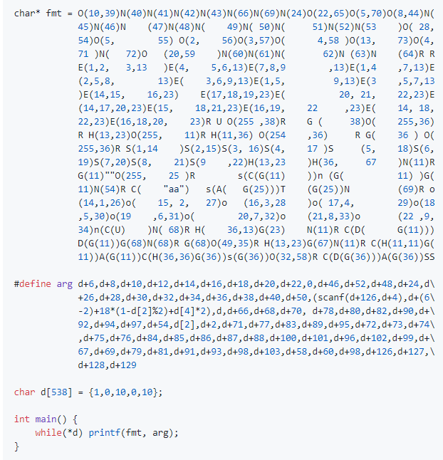
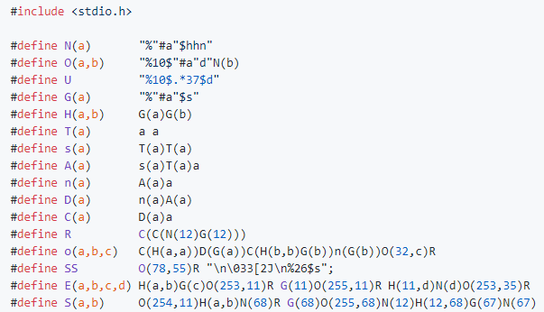
printf-tac-toe
Introducing: printf-tac-toe https://github.com/carlini/printf-tac-toe Created by Nicholas Carlini
Using these principles for reading, writing, and computing, this person created a functioning tic-tac-toe game that is implemented with a single printf call in a loop
He even decorated it in a “%N” shape
He uses the following macros
And to hide all the unnecessary printed characters, he uses a “clear screen” macro (SS in the picture)

Slide 66
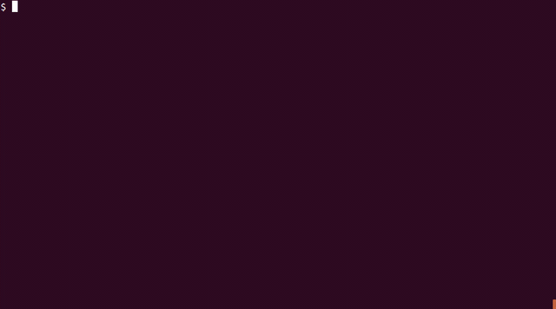

printf-tac-toe
The result – a fully functioning Tic-Tac-Toe game written with a single printf call

Slide 67

Bonus - steg86
This example is more of a “Steganography” than obfuscation:
“Steganography is the practice of concealing a message within another message or a physical object. In computing/electronic contexts, a computer file, message, image, or video is concealed within another file, message, image, or video.”
-Wikipedia

Slide 68

Bonus - steg86
In the x86 instruction set there are many ways to encode instructions For example, this is the encoding table for xor:
Instructions involving memory access have an R/M field which can be either Register or Memory. It encodes the source or the destination, depending on the opcode.
As a result, we have Register to R/M and R/M to Register instructions.
So, it is possible to encode a register-to-register instruction using either Register to R/M or R/M to Register. For example, “xor eax, eax” can be encoded as both:
Assembly | Instruction | Encoding
xor eax, eax | xor R/M, R | 31 C0
 | xor R, R/M | 33 C0
Taken from Intel® 64 and IA-32 Architectures Software Developer’s Manual
Notes:
The “C0” (11 000 000) byte is the MOD-REG-R/M byte
And it specifies the instruction operands and their addressing mode:
MOD (11) = register addressing mode
REG (000) = EAX
R/M (000) = EAX

Slide 69
Bonus - steg86
Assembly | Instruction | Encoding
xor eax, eax | xor R/M, R | 31 C0
 | xor R, R/M | 33 C0
While there are many ways to put 0 into the eax register: “sub eax, eax”, “lea eax, [0]”, “and eax, 0” and more... These instructions have different lengths and slightly different behaviour, like setting and clearing different flags in the flags register.
The two encodings for “xor eax, eax” represent the same instruction. Because they have same length and have the exact same behaviour, they can be used interchangeably without affecting the logic of the program.
By using this duality, we can assign to one instruction encoding the value 0, and assign to the other instruction encoding the value 1. Then we can encode our own data by interchanging between the two.
In fact, there are even more instruction that use this R/M field and have more than one encoding, including add, sub, mov, cmp, and, or, sbb. And for all variation of each instruction – 8/16/32/64 bit.

Slide 70

Bonus - steg86
Introducing steg86 - “A steganographic tool for x86 and AMD64” https://github.com/woodruffw/steg86
Given a binary and a message, this tool converts the message into a bit array. Then finds every interchangeable instruction in the program, and changes its encoding to be corresponding to the message bit.
The result is a modified binary that has the same size and behaviour, except it secretly includes our message.
For example – hiding a cake in /bin/bash:
(Which is pretty cool)

Slide 71

Conclusion
We’ve seen many creative ways to make it harder for people to understand code
IOCCC Pi – using creative macros
main is usually a function – define main as int array
Read the docs – hide code in documentation
Movfuscator – reduce all instructions to mov
Reductio – reduce all programs into one universal code
Brainfuck – turing complete machine
JSFuck – abusing Javascript
Irregular expression – using regex to determine if a number is prime
printf-tac-toe – reduce program into a single printf call
steg86 – hide messages in executable binaries
I hope that each of you found at least one example you liked that made you want to share it with a friend

Slide 72
References
IOCCC Pi - https://en.wikipedia.org/wiki/International_Obfuscated_C_Code_Contest#Pi
Main is usually a function - http://jroweboy.github.io/c/asm/2015/01/26/when-is-main-not-a-function.html
Read the docs - inspired by WOPR – challenge #7 of Flare-On 6 (2019)
Movfuscator - https://github.com/xoreaxeaxeax/movfuscator
Demovfuscator - https://github.com/kirschju/demovfuscator
Reductio - https://github.com/xoreaxeaxeax/reductio
Brainfuck compiler - https://github.com/elikaski/BF-it
JSFuck - https://en.wikipedia.org/wiki/JSFuck
Irregular Expression - https://iluxonchik.github.io/regular-expression-check-if-number-is-prime/
printf-tac-toe - https://github.com/carlini/printf-tac-toe
steg86 - https://blog.yossarian.net/2020/08/16/Hiding-messages-in-x86-binaries-using-semantic-duals

Slide 73

Questions?

Slide 74

Thanks!

